Slide 1
Great Open Source Compliance For Everyone
Available under the CC Attribution-NoDerivatives 4.0 International license.

Slide 2

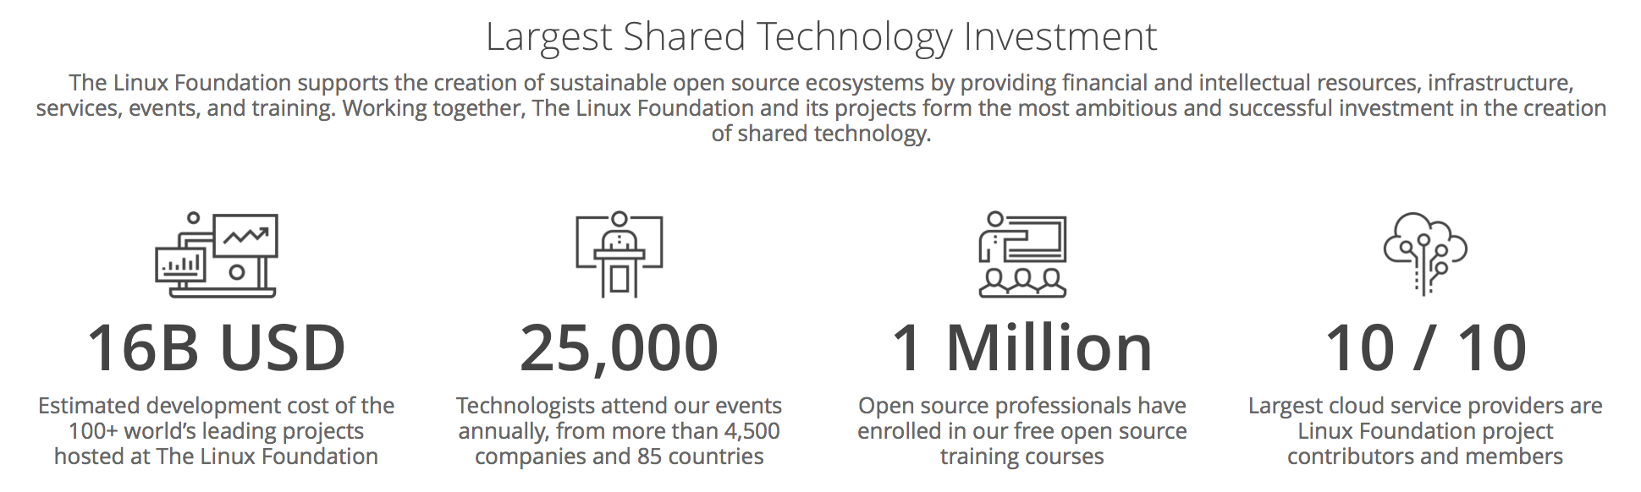
Notes:
To provide context for the OpenChain Project we need to look at the larger world of open source. The Linux Foundation, which hosts the OpenChain Project, also hosts 100 other projects driving open source adoption. Most of the projects create code, some create governance and compliance information. We are looking at 16 billion USD of collaborative development and tens of thousands of contributors alongside over 1,000 supporting companies.
2

Slide 3
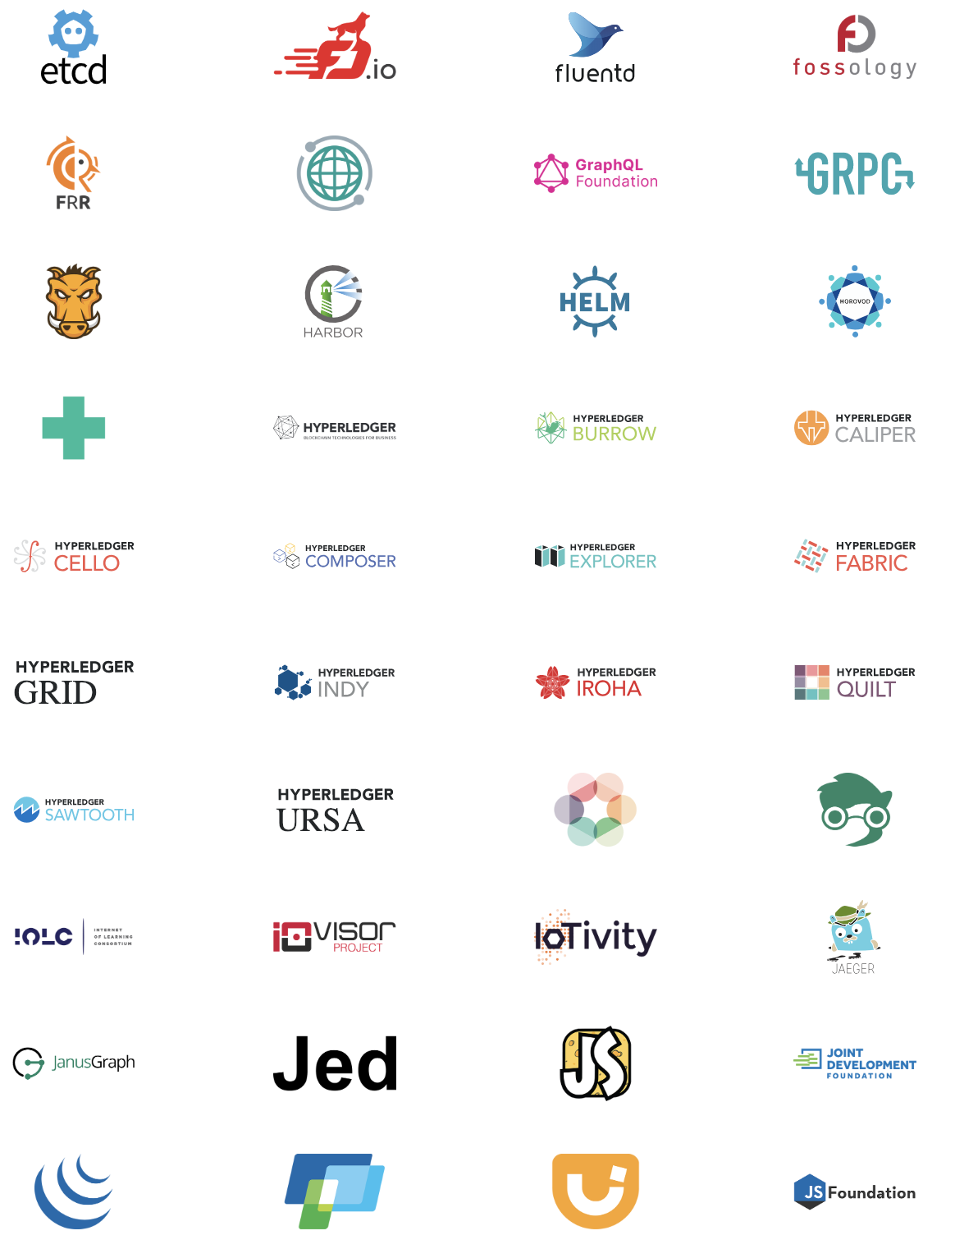
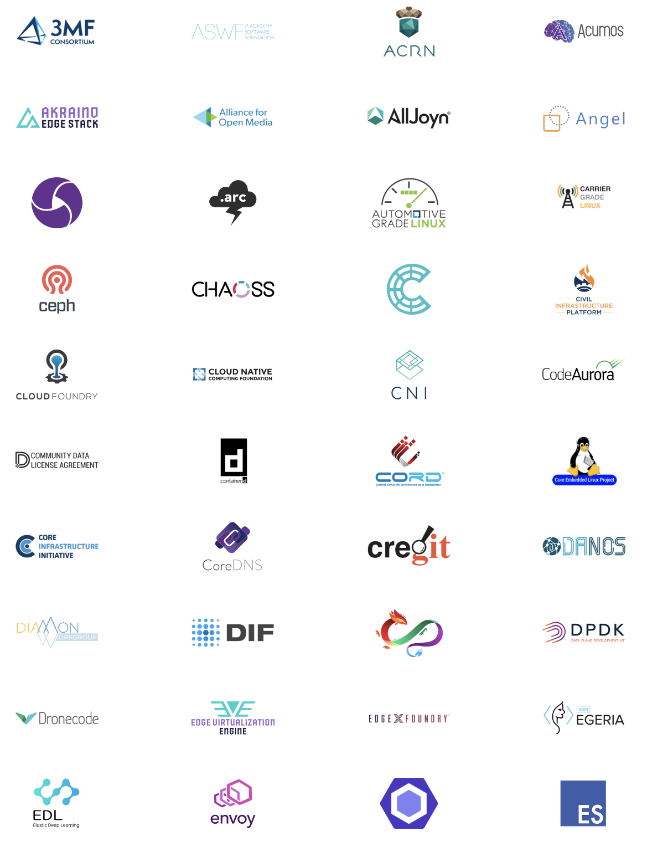
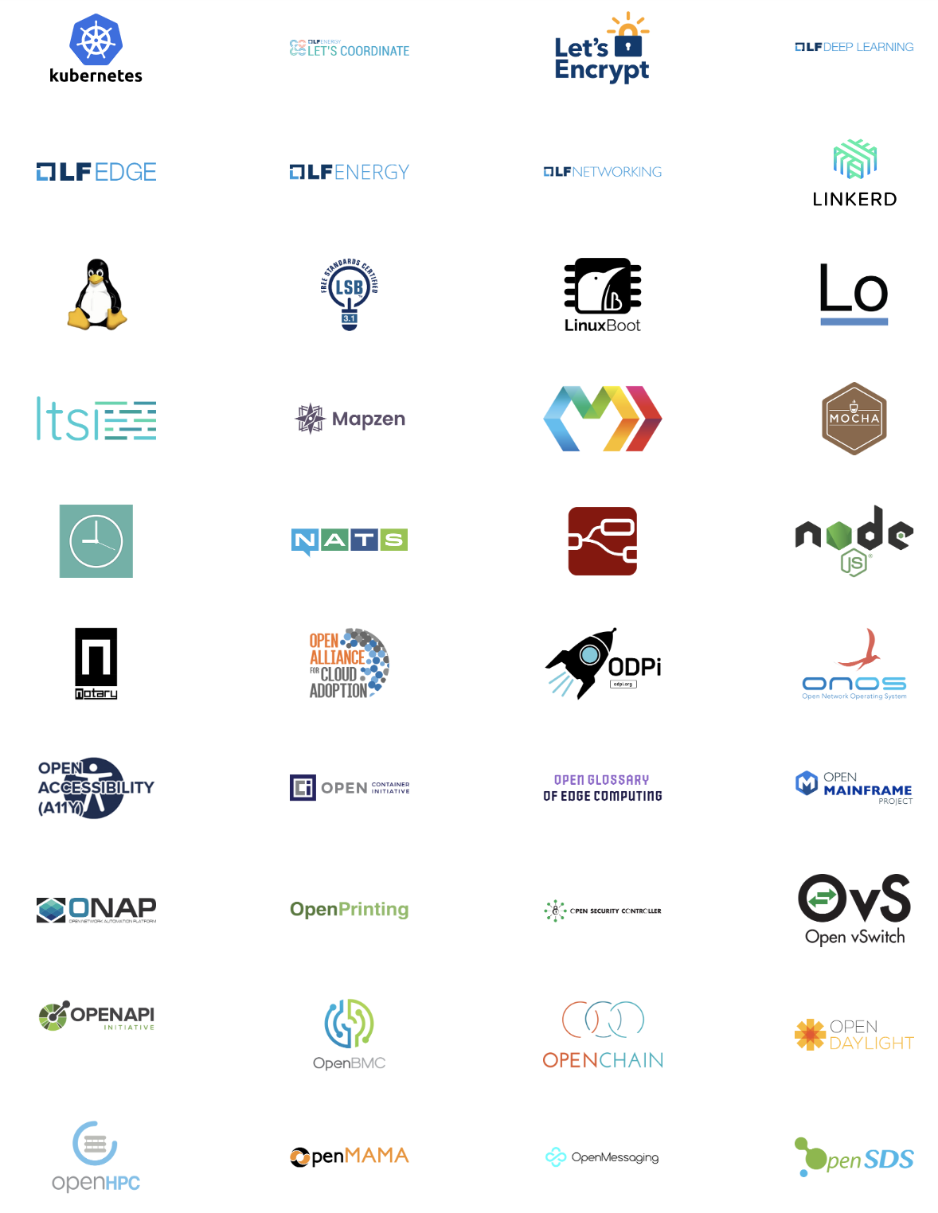
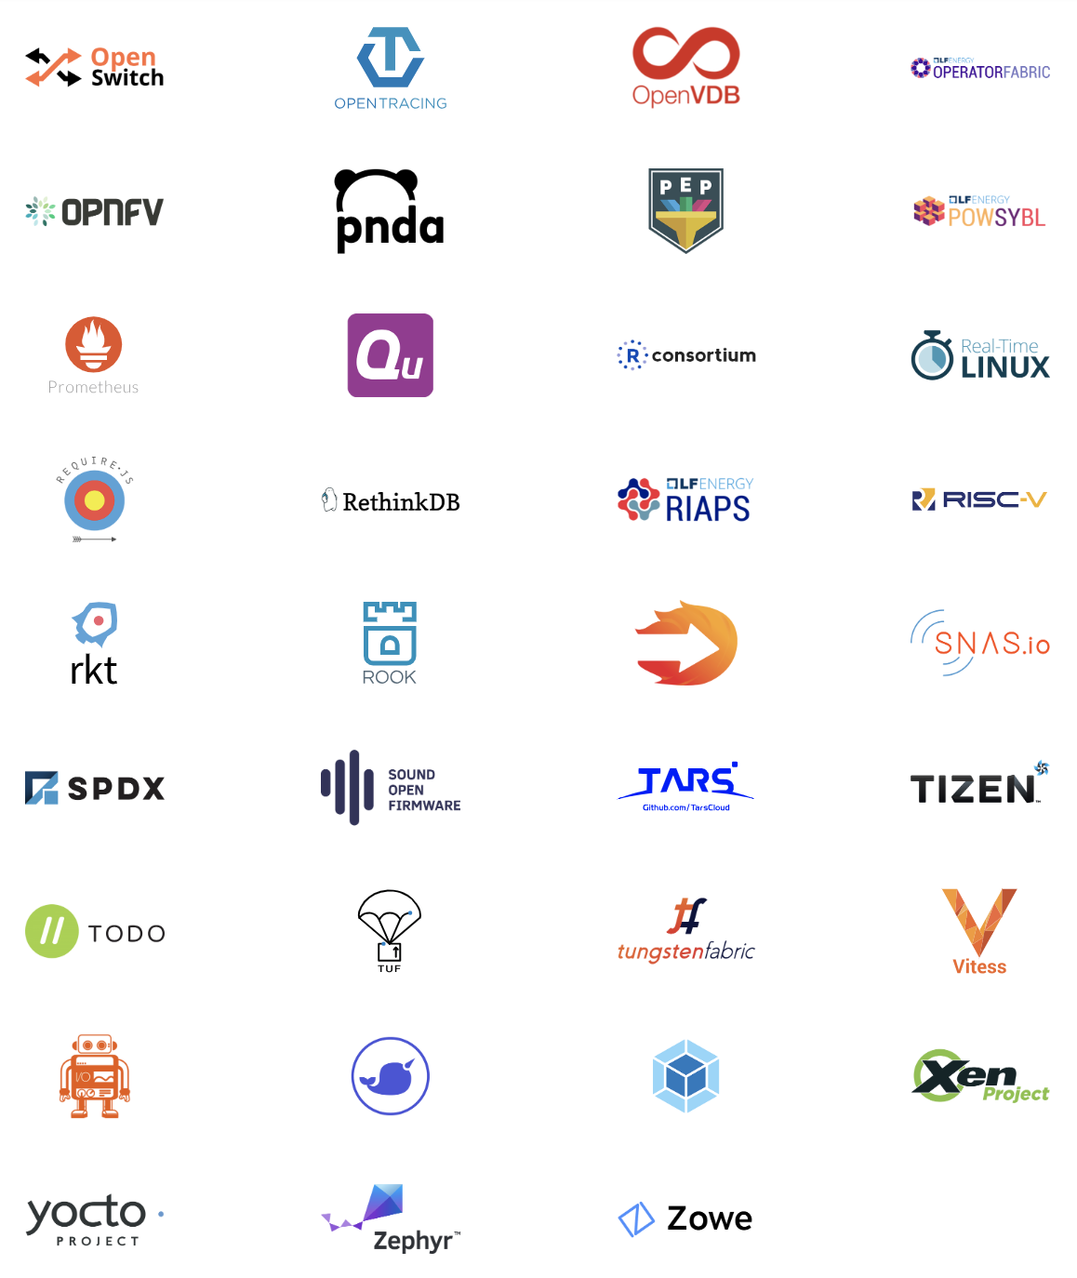
Notes:
Here is a quick tour of Linux Foundation projects. We are not going to dwell on any single project. We are looking at scale.
3

Slide 4
Compliance – A gateway to access
Notes:
Open source license compliance is a gateway to accessing projects like these. It is gateway to 16 billion dollars of code, platforms that can accelerate any market.
4

Slide 5
How do I trust my open source supply chain?
Notes:
There is a clear business context for compliance. While often characterized as a boring legal matter, compliance is core to effective strategic engagement with open source technology.
5

Slide 6
The OpenChain Project defines the key requirements for a quality compliance program.
Notes:
The most important thing is that the OpenChain Specification defines the requirements for a quality compliance program.
6

Slide 7
OpenChain is a simple, effective standard for organizations of all sizes in all markets.
Notes:
This definition is kept as simple and as broadly applicable as possible to ensure global accessibility.
7

Slide 8
OpenChain Defines Inflection Points
upstream
downstream
inbound
Training
Policy
outbound
Process
Notes:
It defines the big picture, showing the inflection points where a company should have processes, policies or training.
8

Slide 9
Companies have the flexibility to decide the content of each specific process, policies and training.
Notes:
The OpenChain Specification confirms a company has open source processes, policies and training.
Companies have the flexibility to decide the content of each specific process, policies and training.
9

Slide 10
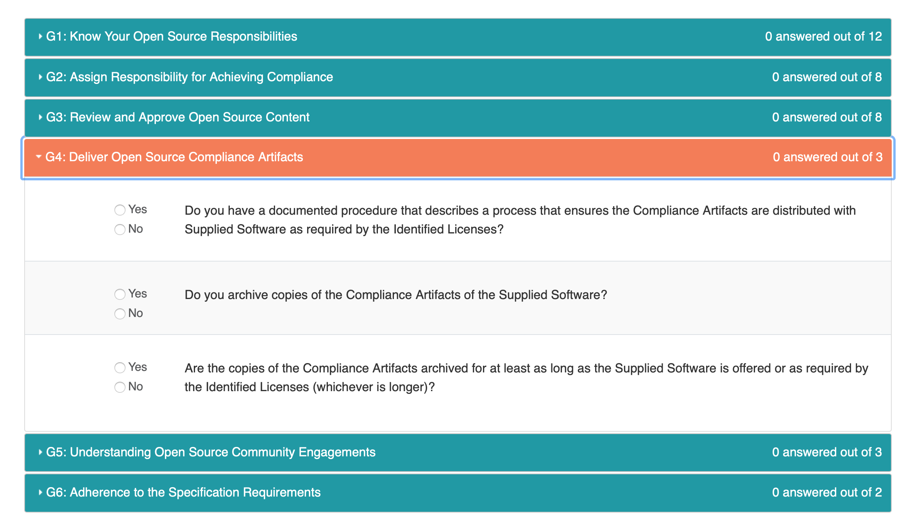
Our Online Self-Certification Questionnaire
Notes:
Another great announcement today related to conformance. We have a free self-certification web app and – as of today – we are announcing a huge revamp. The updated web app aligns with the user experience in sister projects, and provides a responsive interface for computers, tablets and mobile phones.
10

Slide 11
If a company can answer “Yes” to each question they are OpenChain Conformant.
Notes:
The exciting thing is how easy this is. If a company can answer Yes to each question they are OpenChain Conformant. This is a process companies can go through at their own pace and in private on the online Web App. Their conformance is only made public after they have passed the questionnaire and finalize their self-certification.
11

Slide 12
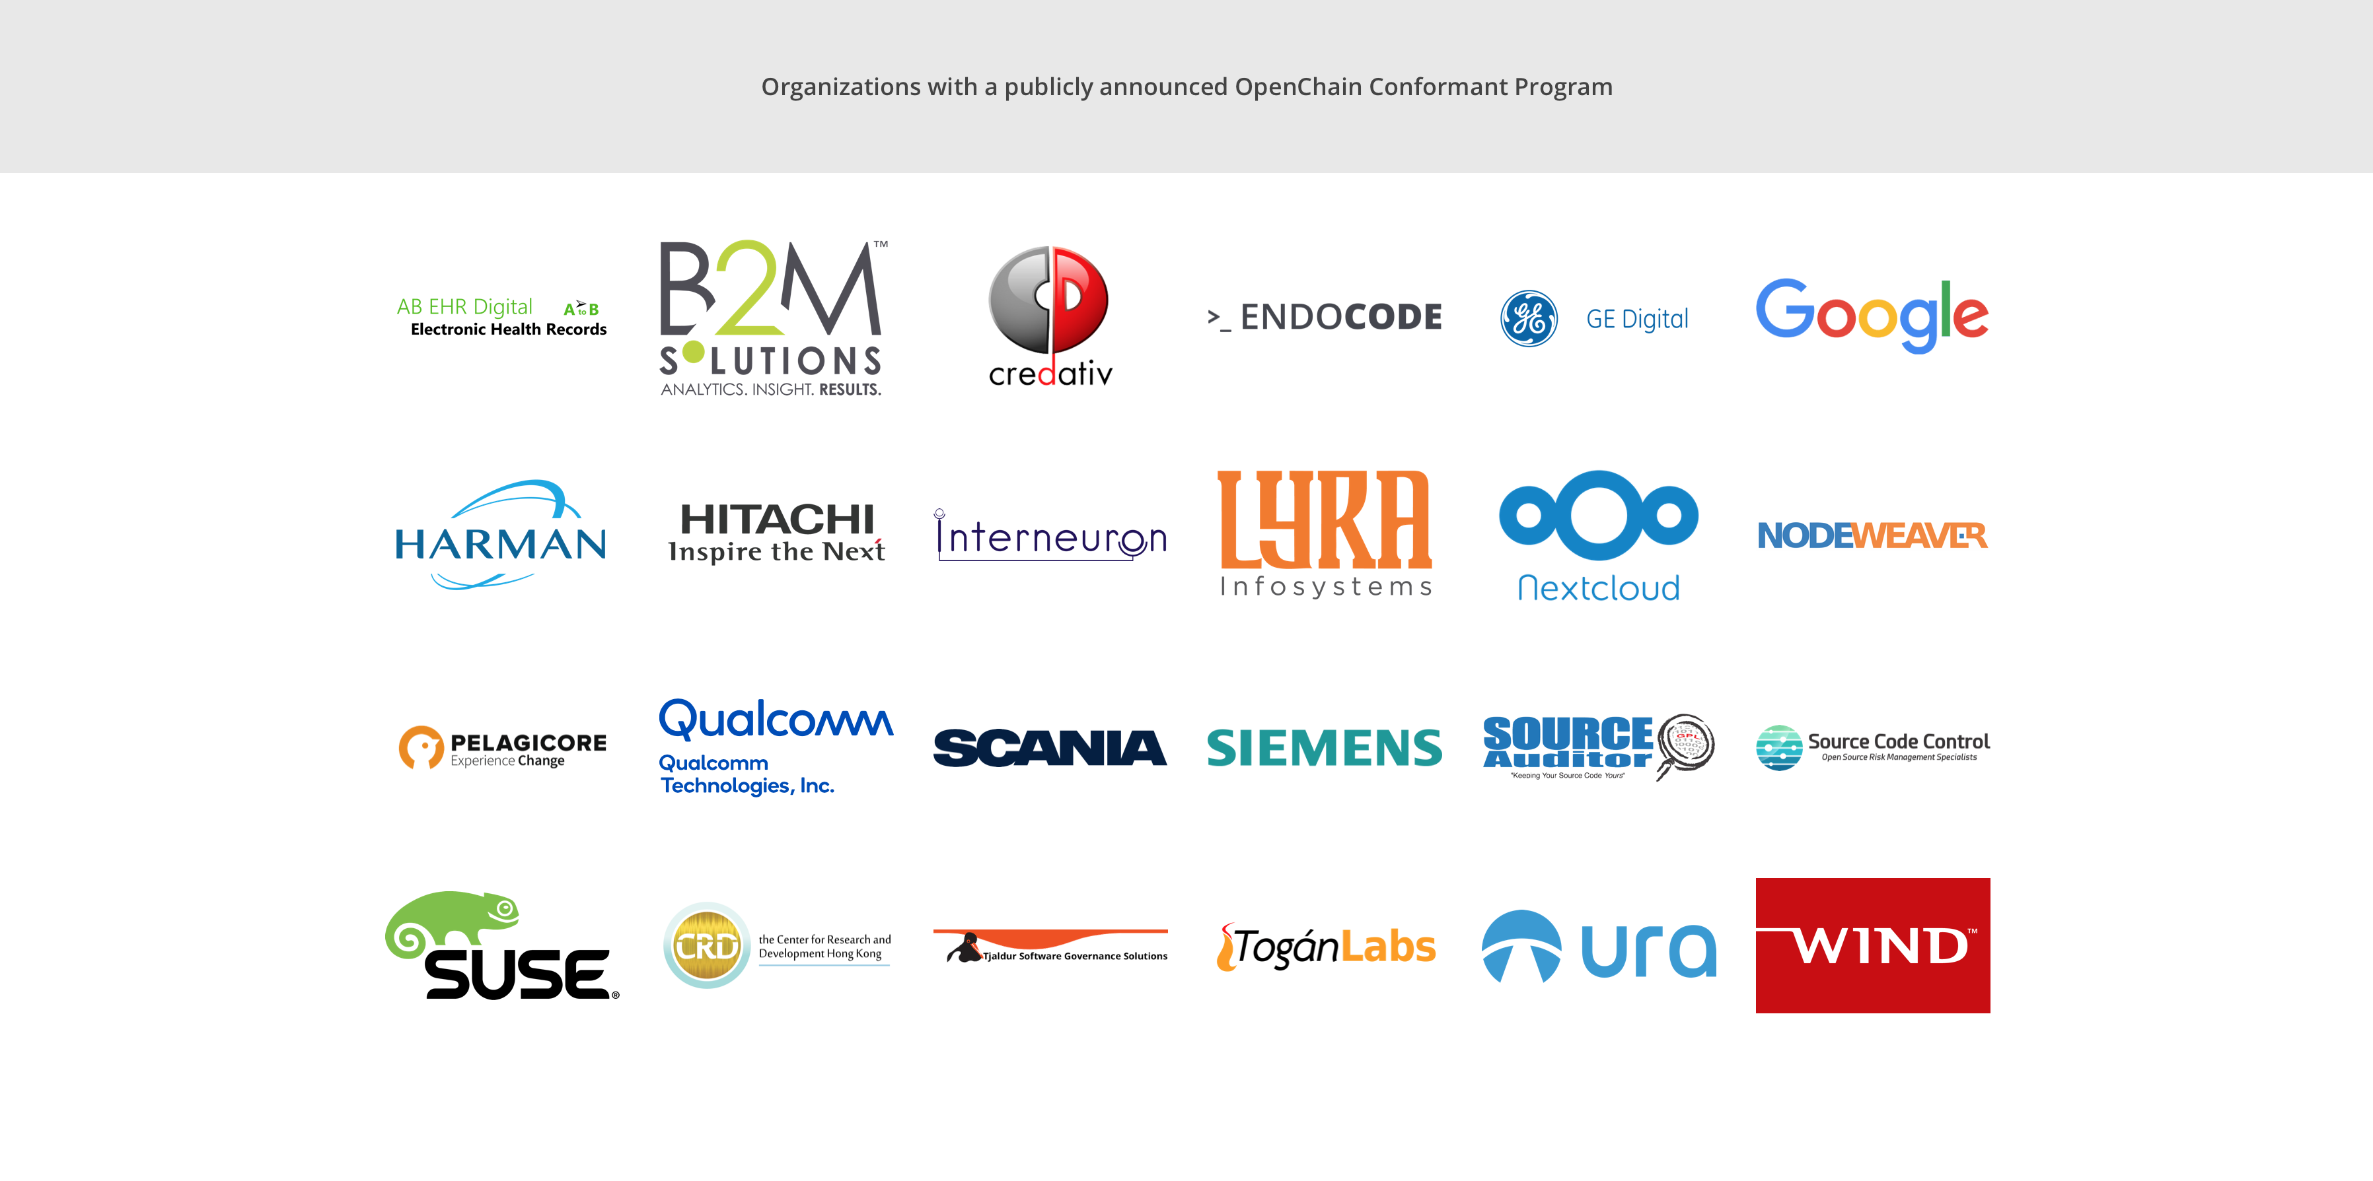
12
Notes:
There are a number of companies with a publicly announced OpenChain Conformant program. These companies come from a wide range of industries and represent a wide range of company sizes. Of course, there are many more undergoing OpenChain Conformance or without a publicly announced program.

Slide 13
Notes:
Companies that meet the OpenChain Specification requirements can use a badge to identify their OpenChain Conformant program and the products that went through this program.

Slide 14
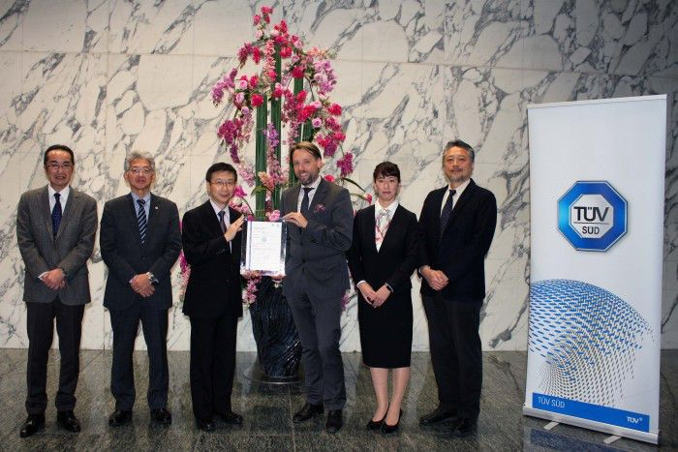
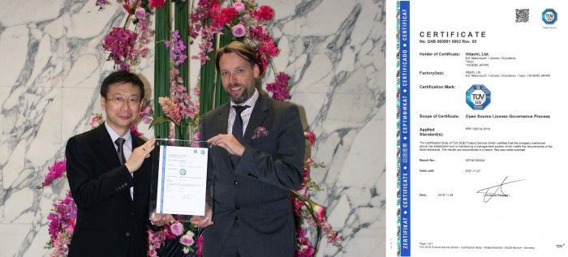
Audited Certification is an Option
Notes:
We have seen the energy around the project emerge in interesting and useful new ways. For example, a German certification authority called TUV Sud has recently started to offer an open source compliance certification based on OpenChain. This is useful for areas such as automotive where TUV Sud is synonymous with quality checks by a third party.
14

Slide 15
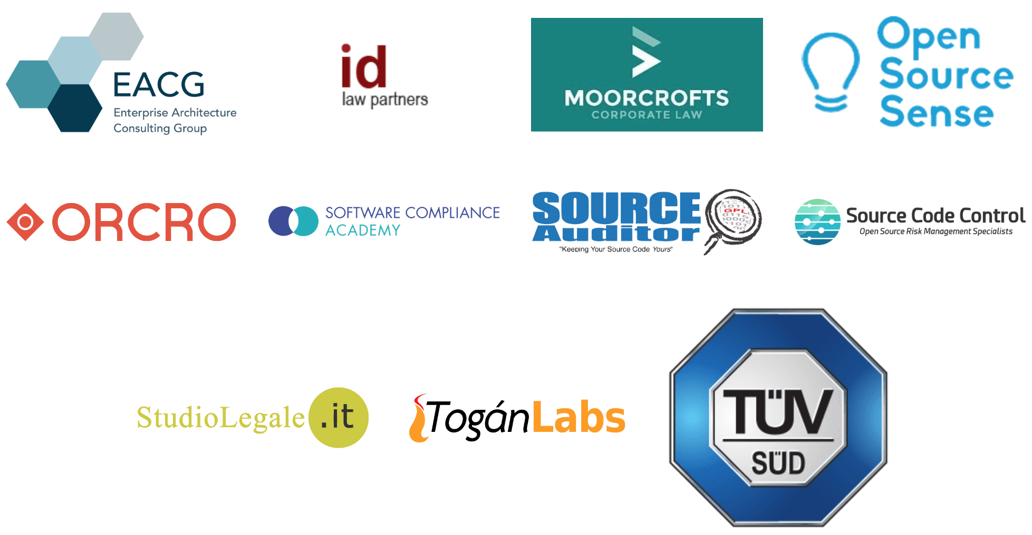
Commercial Support Is Available
Notes:
We have seen the energy around the project emerge in interesting and useful new ways. For example, a German certification authority called TUV Sud has recently started to offer an open source compliance certification based on OpenChain. This is useful for areas such as automotive where TUV Sud is synonymous with quality checks by a third party.
15

Slide 16
The OpenChain Project provides comprehensive and free reference material to help with conformance.
Notes:
To support this journey – especially around filling in the gaps identified when going through the OpenChain Conformance process – companies can use the library of material in the OpenChain Curriculum.
16

Slide 17
OpenChain is run by user companies for user companies.
Notes:
The OpenChain Specification confirms a company has open source processes, policies and training.
Companies have the flexibility to decide the content of each specific process, policies and training.
17

Slide 18
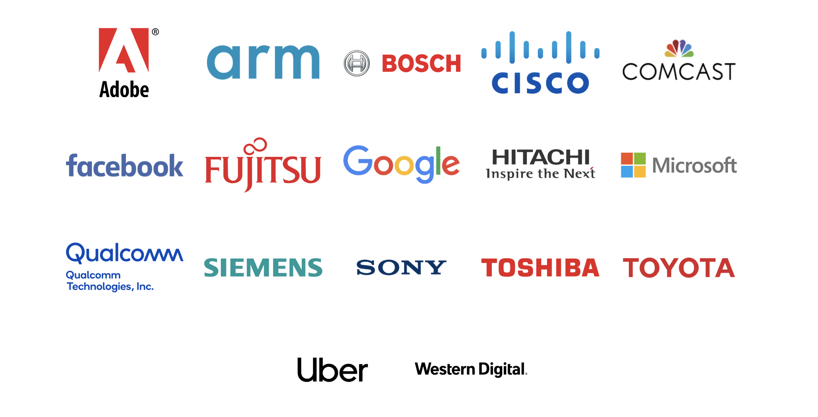
18
Notes:
Here are the current Platinum Member companies in the OpenChain Project. As you can see, they are diverse, with Adobe standing shoulder to shoulder with Toyota in establishing this standard for open source compliance.

Slide 19

OpenChain is Community First
Notes:
The individuals involved in our community are diverse. You can see here that the leads of our various work teams are from areas of the OpenChain community outside of the Platinum Members. We regard this diversity as a great strength in the project.

Slide 20
Work Teams supporting OpenChain:
Specification - Chaired by Mark Gisi (Wind River)
Conformance - Chaired by Miriam Ballhausen (SCA)
Curriculum - Chaired by Alexios Zavros (Intel)
Onboarding - Chaired by Nathan Kumagai (Qualcomm)
Notes:
The community is very inclusive and all of our day to day work is done via work teams that meet via phone twice a month. We do a lot of our work on these calls – where we publish slides and minutes – and we also do a lot of work on our mailing lists. Everyone is welcome to both. Indeed, we are actively seeking knowledge and contributors from all over the world. We are building a global standard and we want it to have a comprehensive global perspective.
20

Slide 21
OpenChain: raising all the boats for the benefit of all.
Notes:
OpenChain is all about making everything more effective. A good concept to capture this is that we are raising all the boats, a process that will benefit all.
21

Slide 22
Be part of this
Join the community:
https://www.openchainproject.org/community
Self-certify or Health Check an organization:
https://certification.openchainproject.org
Notes:
You are invited to be part of this. You can join our community by visiting our website, subscribing to a mailing list, or hopping on one of our calls. You can also access the self-certification web-app and check how your current overarching processes map to international norms. Naturally that is completely private until you want to declare OpenChain Conformance.
22

Slide 23
coughlan@linux.com
Notes:
And that’s it. OpenChain is the standard that explains the key requirements of quality open source compliance programs. It is open, it has a vibrant community, and we want to work with you. Thank you so much for your time. Any questions?
23

